Slide 1
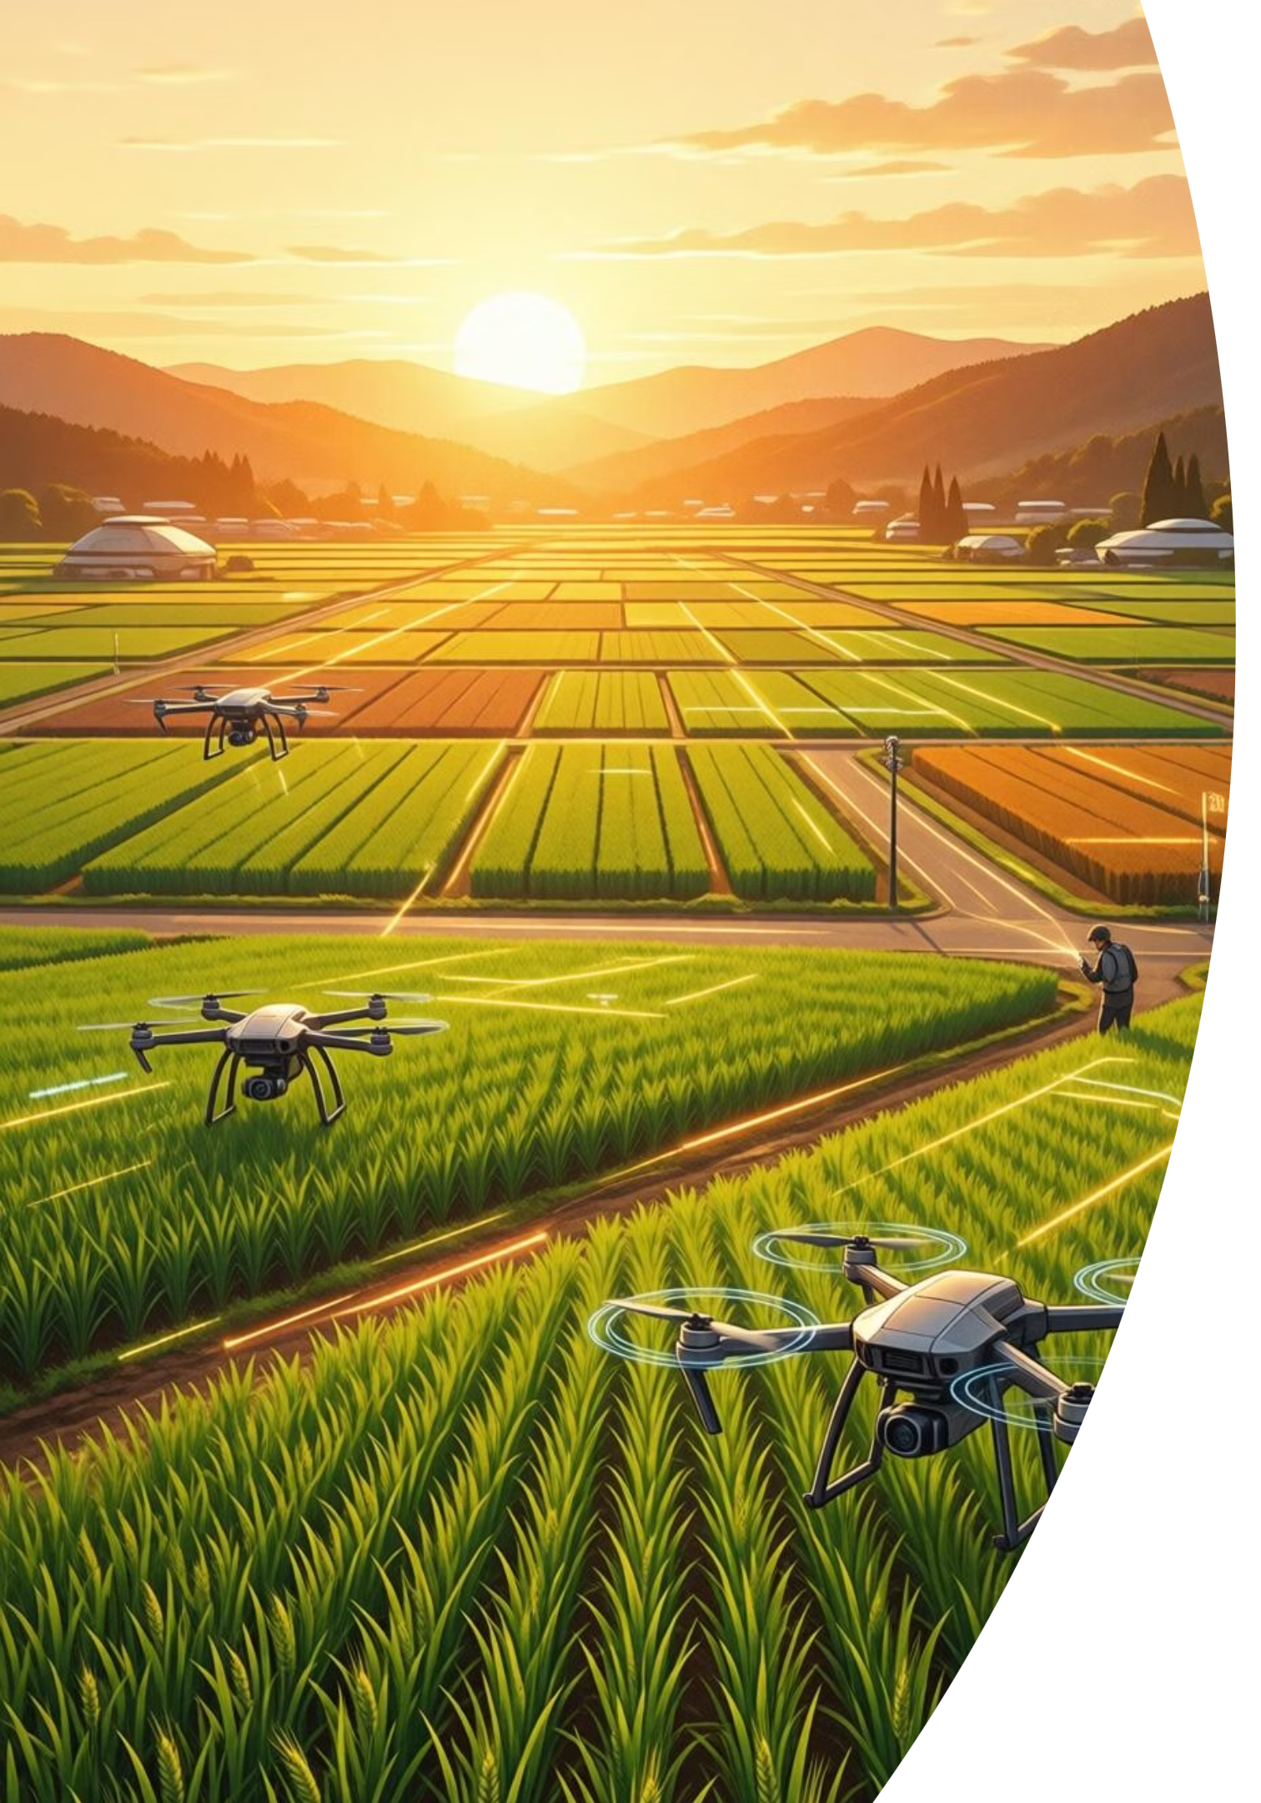
AI-Driven Web Application for Automated Disease Detection in Rice and Pulse Crops
An Infosys Springboard Virtual Internship 6.0 project, empowering farmers with AI for healthier harvests.
Mentor & Coordinator
Mentor: Sasank Nukala
Coordinator: Uttam

Slide 2
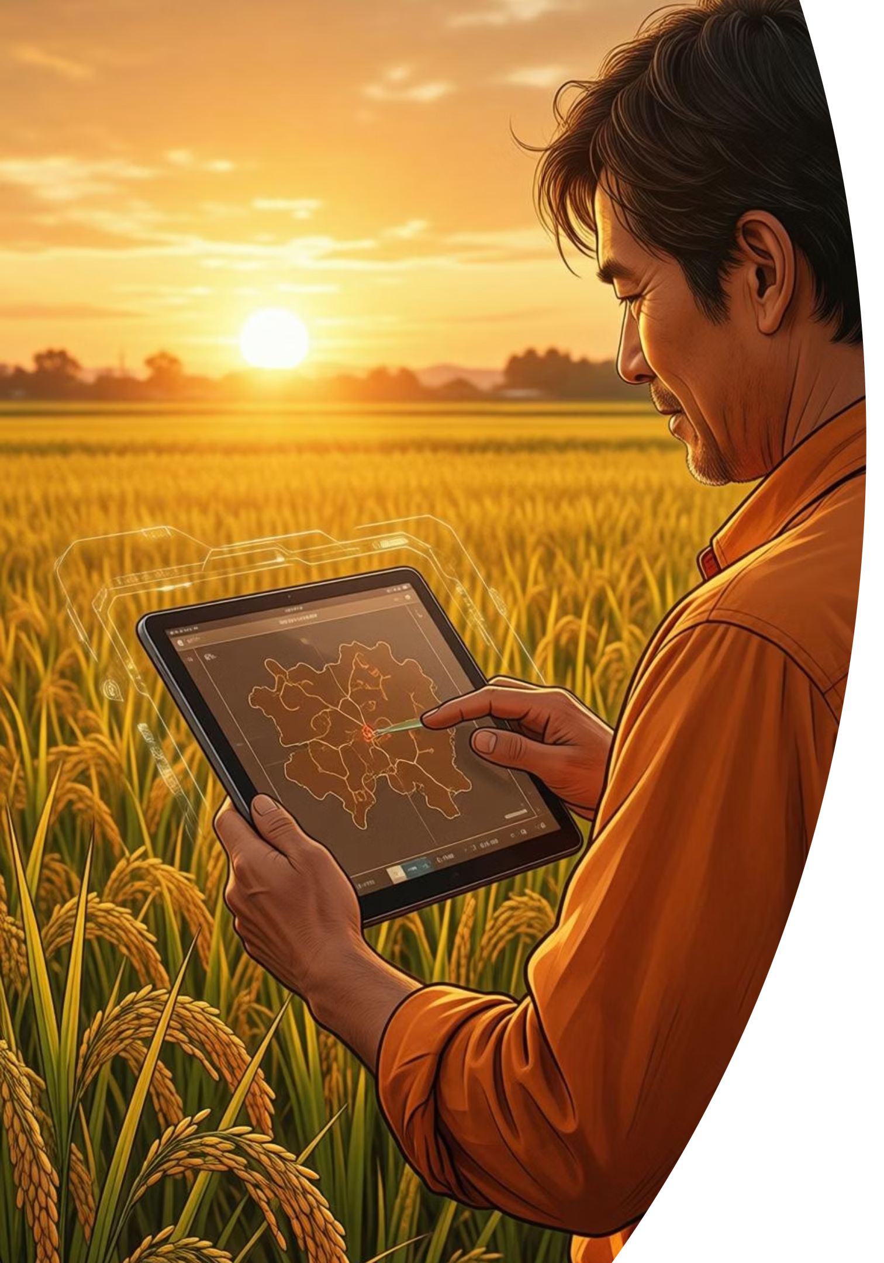
Project Overview: AI-Driven Disease Detection
Leveraging deep learning and a user-friendly web interface to detect and diagnose crop diseases from leaf images.
1
2
Primary Objective
Key Highlights
Build a production-ready Streamlit web app with CNN for accurate leaf disease classification in rice and pulse crops.
Custom CNN, Streamlit UI, 3 disease classes, PDF reports, AI Chatbot, Secure Auth.
3
Target Users
Farmers, Agricultural Extension Officers, Agronomists, Research Institutions.
Infosys SpringBoard

Slide 3
Problem Statement: Agricultural Losses
Problem Statement
Crop diseases pose a significant threat to global food security and farmer livelihoods. Our project directly addresses these pressing issues.
Time-Consuming & Error-Prone
Costly Laboratory Testing
Limited Expert Access
Reduced Yield and Income
Infosys SpringBoard

Slide 4




Project Purpose: Smart & User-Friendly AI
Project Objective
Specific Objectives
Expected Outcomes
Identify rice and pulse crop diseases using AI-powered image analysis for timely farmer intervention.
Robust CNN design, secure authentication, real-time predictions, SOLID principles, comprehensive testing.
Intuitive tool, accessible interface, early detection, targeted treatments, comprehensive documentation.
Real-World Impact
Early detection, web-based accessibility, cloud scalability, and data-driven decisions reduce crop loss and pesticide misuse.
Infosys SpringBoard

Slide 5

Dataset & Preprocessing for AI Accuracy
Dataset Overview
Total Images: 300+ collected
Image Size: Standardized to 224×224 pixels
Format: JPEG, JPG, PNG
Organization: Structured folders per class
Validation: Manual to remove corrupt samples
Disease Classes (3 Total)
Includes Bacterial Leaf Blight, Brown Spot, Leaf Scald.
Preprocessing & Augmentation
Input Image → Resize(224*224) → RGB Conversion → Convert to Tensor → Normalization(ImageNet mean & Std).
Data Augmentation Techniques like random horizontal flip, rotation, color jitter, are used.
Infosys SpringBoard

Slide 6
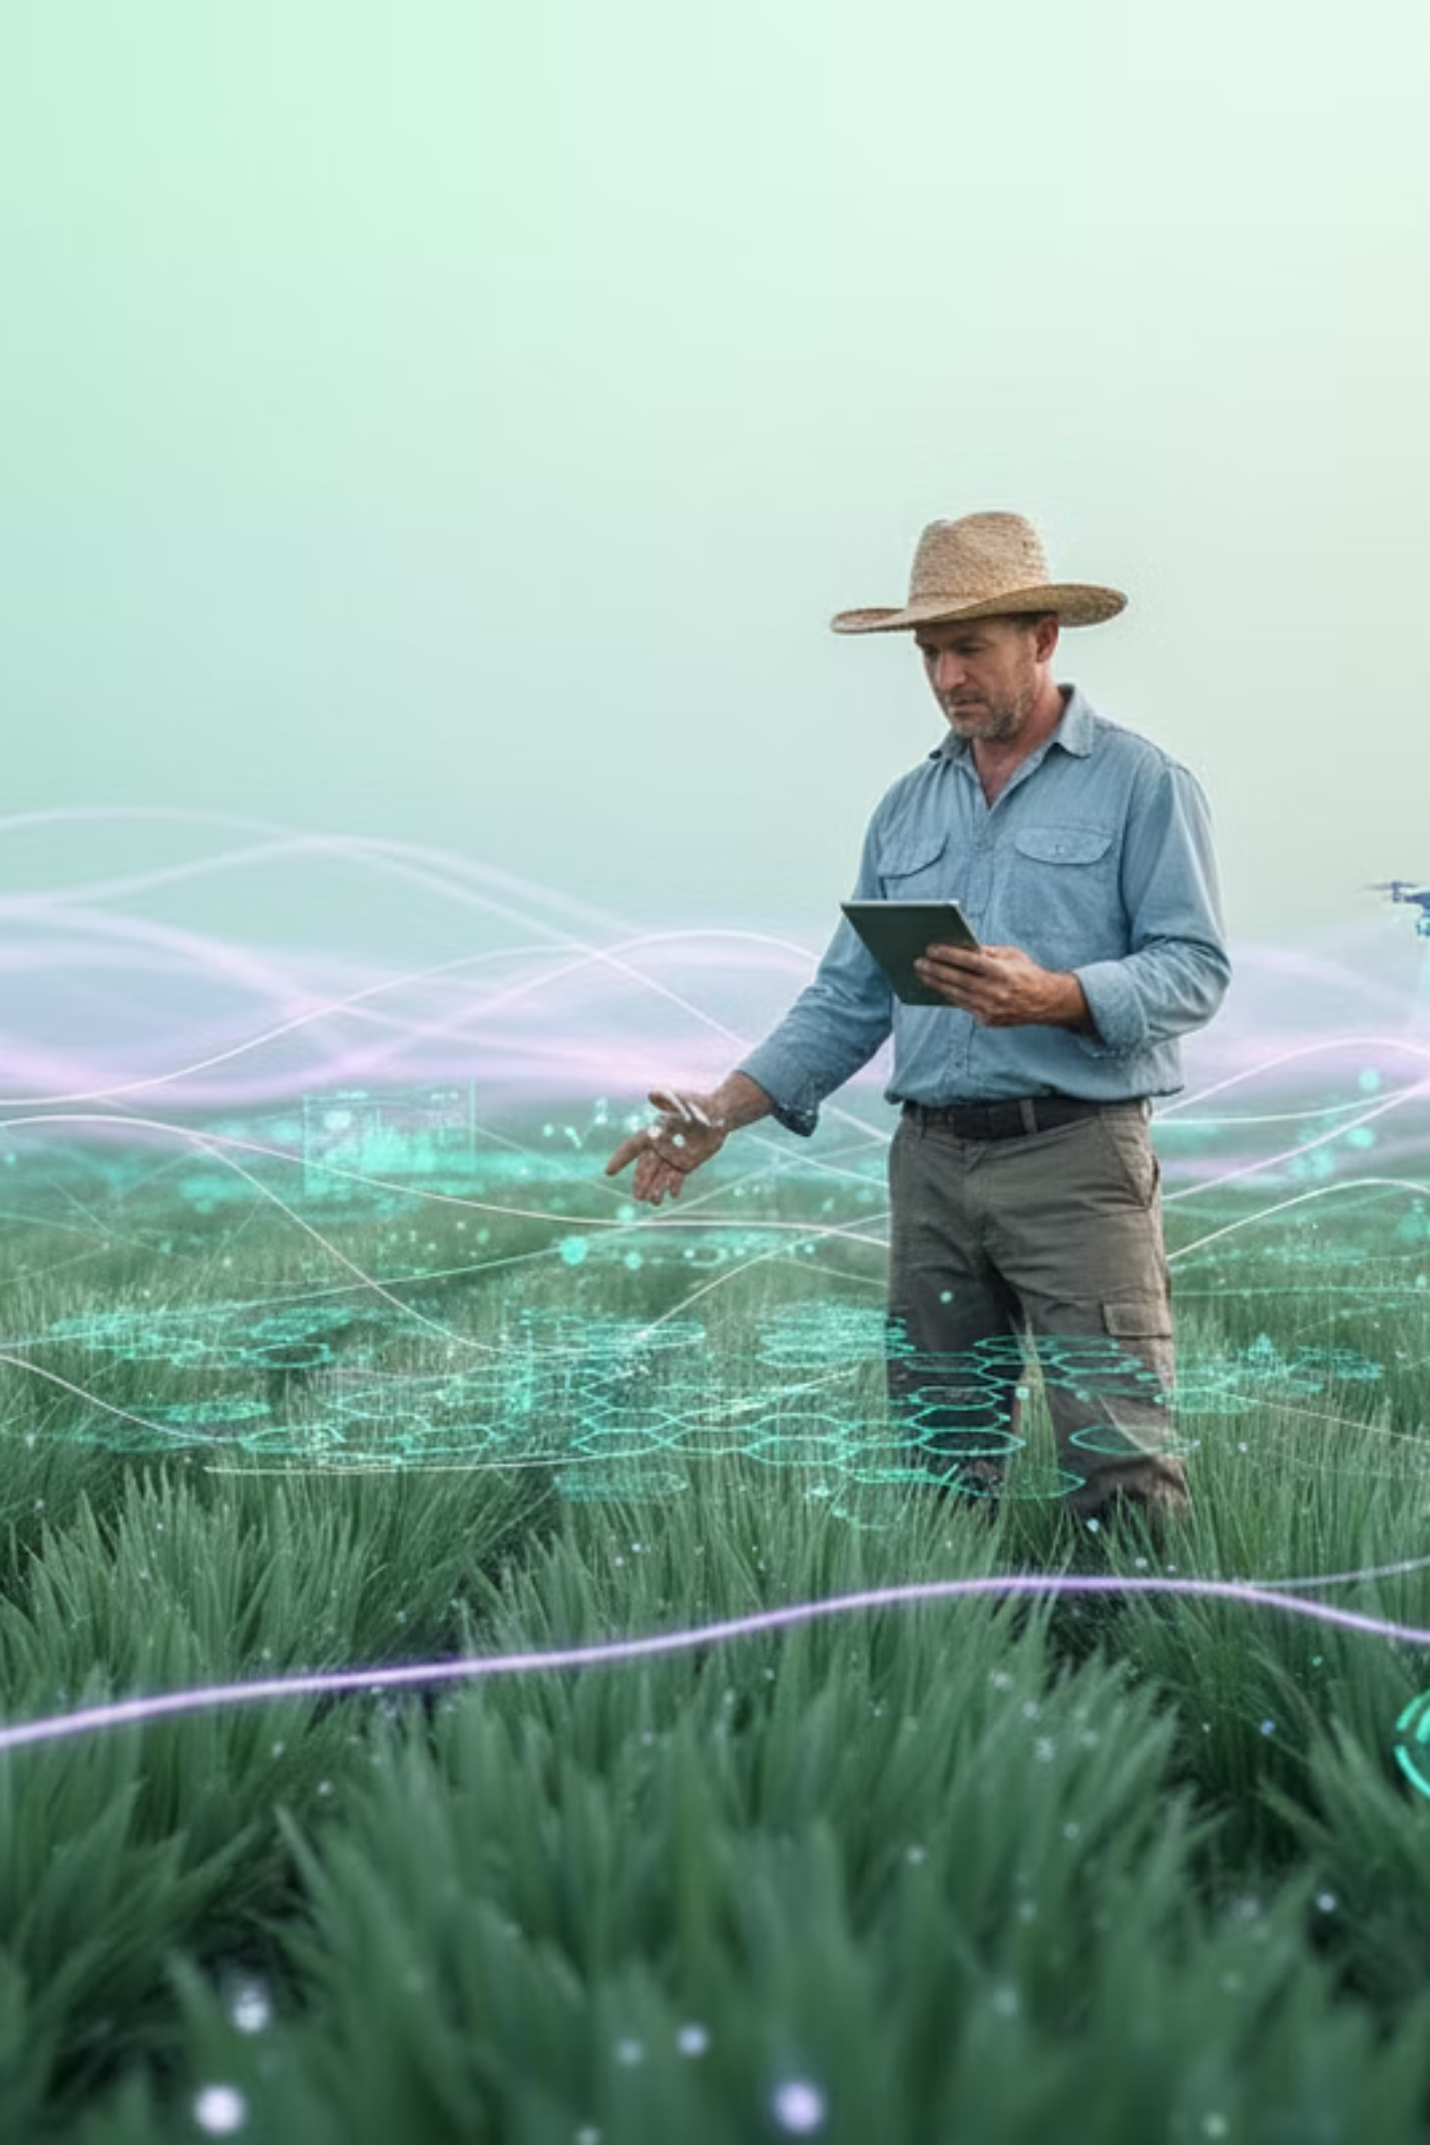






Seamless Workflow for Rapid Diagnosis
User Login
Secure access to the platform via personalized accounts.
Upload Leaf Image
Simple, intuitive interface for submitting crop leaf photos.
AI Model Prediction
Deep learning algorithms swiftly analyze the uploaded image.
Disease Identified
Instant diagnosis of specific crop diseases with high accuracy.
Cure Suggestions
Receive recommended treatments and essential care instructions.
PDF Report Generated
Download a comprehensive, detailed report for future reference.
Infosys SpringBoard
Notes:
Seamless workflow for rapid diagnosis of crop diseases Start with secure user login to access the platform Intuitive interface for uploading crop leaf photos Deep learning AI models quickly analyze the uploaded images Instant and accurate identification of specific crop diseases Receive recommended treatments and essential care instructions Download a comprehensive PDF report for future reference

Slide 7
How Disease Detection Works: The 6-Phase Pipeline
01
02
Image Acquisition
Preprocessing
User uploads clear leaf image (JPEG/JPG/PNG, max 5MB) with format/size validation.
Resize to 224×224, normalize with ImageNet stats, convert to PyTorch tensor.
03
04
Feature Extraction
Classification
CNN backbone extracts visual features, detecting patterns like spots and lesions.
Fully connected layers map features to 3 classes; Softmax produces probability distribution.
05
06
Confidence Scoring
Result Presentation
Highest probability class selected; 60% threshold ensures reliable predictions.
Disease name, confidence, description, symptoms, recommendations, and downloadable PDF report.
Infosys SpringBoard

Slide 8




Tools and Technologies Used
Our project leverages a robust stack of cutting-edge tools and frameworks to ensure efficiency, scalability, and performance.
Deep Learning
Web & UI
PyTorch
Streamlit
Torchvision
NumPy
Matplotlib
Programming Languages
Backend & Database
Python
SQLite
CSS3
ReportLab PDF Engine
Security & Testing
DevOps
PyTest
Git
BCrypt
GitHub
VS Code
Infosys SpringBoard

Slide 9
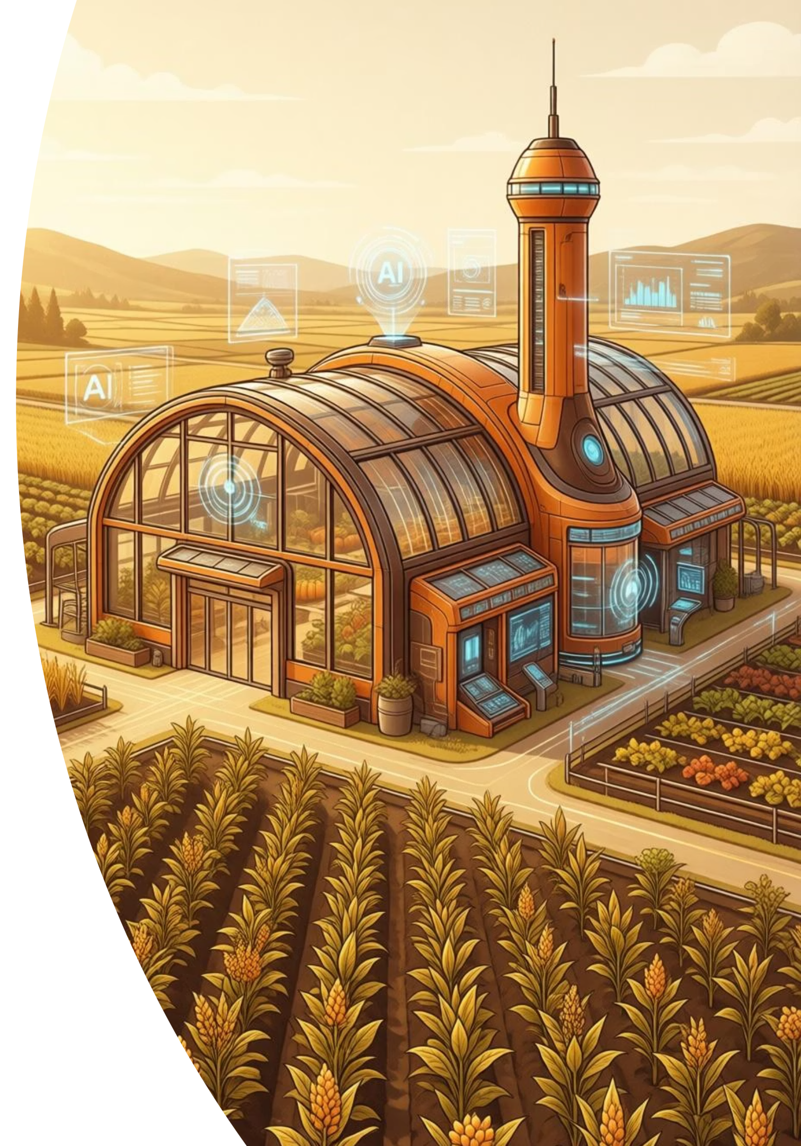



Outcomes
AI-Powered Detection
CNN classifies 3 disease classes with confidence scores.
Web Application
Streamlit-based platform accessible via any browser.
PDF Reports
Downloadable diagnosis reports with recommendations.
Secure Authentication
bcrypt (12 rounds) + SQLite user management.
Infosys SpringBoard

Slide 10
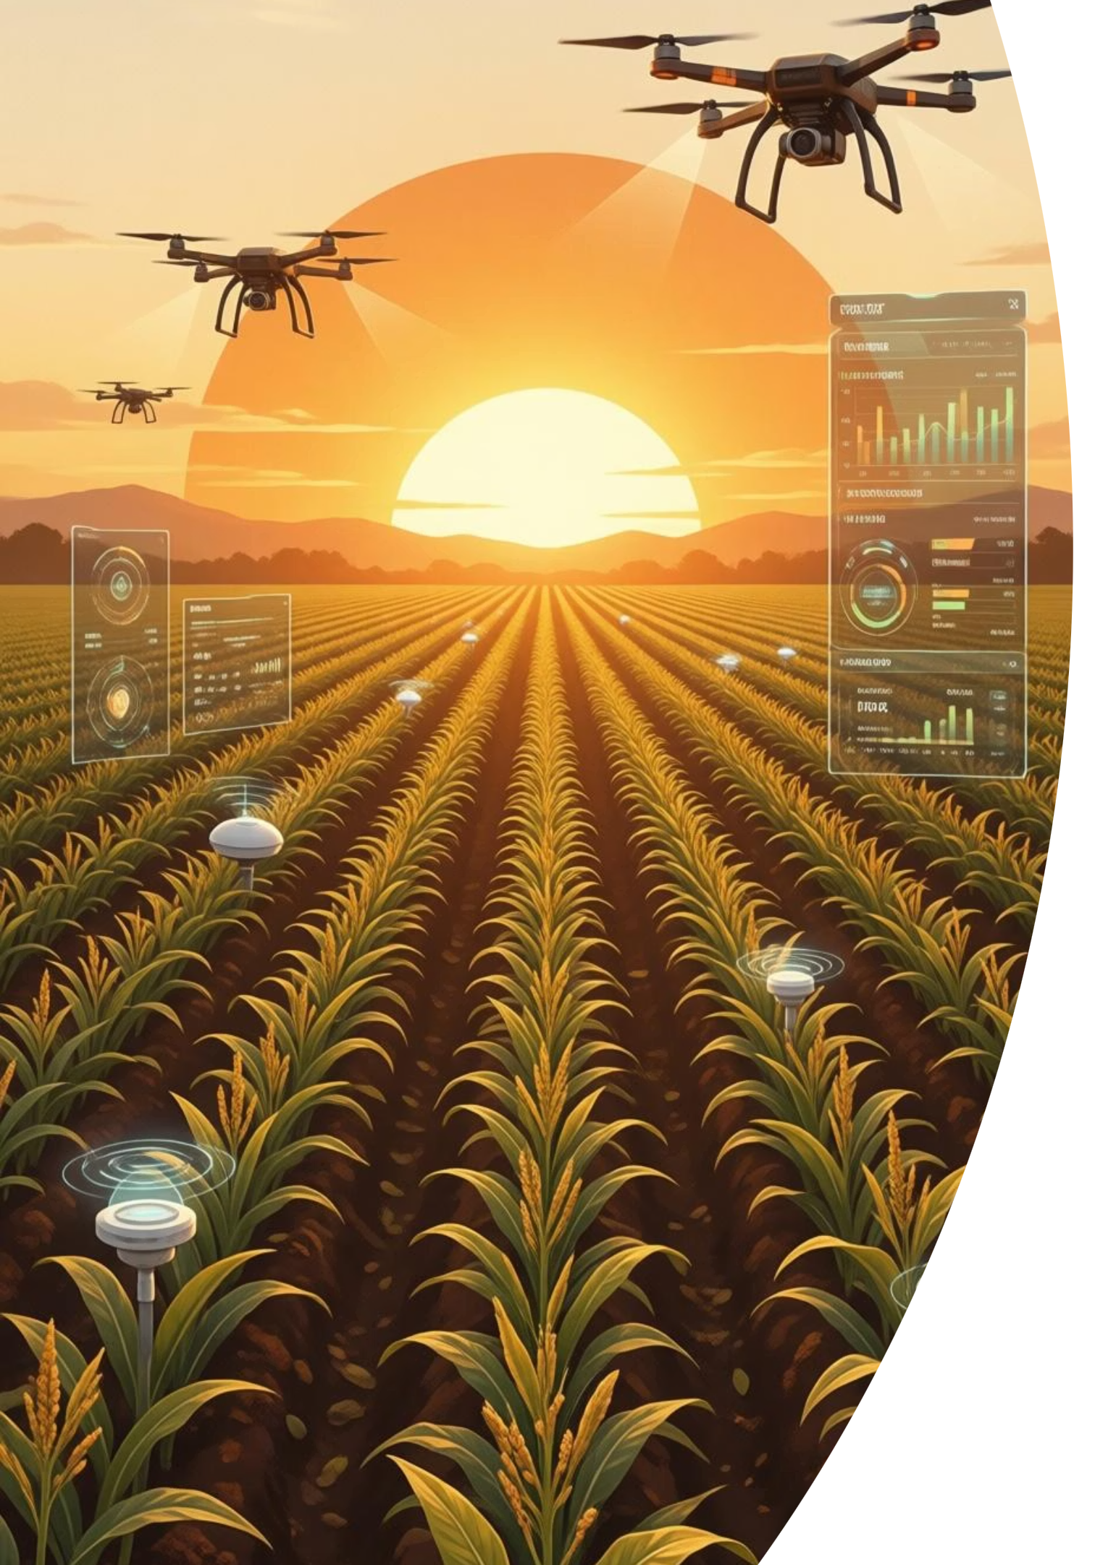
Future Scope: Expanding Horizons
Our vision extends beyond current capabilities to create a truly comprehensive and globally impactful solution for agricultural disease detection.
Expansion
Integration
More diseases (20+ for diverse crops)
GPS for precise location-based insights
Mobile application for on-the-go diagnosis
Real-time weather data for predictive analysis
Offline mode for remote farming areas
Detailed, localized treatment guidance
Support & Accessibility
Multi-language support for global adoption
Expert connect features for personalized advice
Community forums for peer-to-peer knowledge sharing
Infosys SpringBoard

Slide 11


Thank You
We appreciate your time and interest in our AI-driven solution for crop disease detection. Together, we can build a more resilient and sustainable future for agriculture.
Questions?
Get in Touch
Connect with Us
Infosys SpringBoard

